Slide 1
Shweta Lale.
College : DKTE Society's Textile & Engineering Institute
Project: Clone BookMyShow.com in Dark Mode

Slide 2
Agenda
Problem Statement
Project Overview
Who are the End Users?
Your Solution and its value proposition
The wow in your solution
Modeling
Result

Slide 3
Clone BookMyShow.com Homepage in Dark Mode

Slide 4
Problem Statement
BookMyshow.com is an online booking platform for movies, shows, Live Events, Outdoor events, etc.
The BookMyshow.com is available in just light mode. Some users are preferring dark mode as it has less eye problems. The dark mode feature would be designed to help reduce eye strain and provide a more comfortable experience for users while browsing and booking tickets in low-light conditions.
But website is just available in the light mode which can cost them in terms of losing the client.

Slide 5
Project Overview
Design and User Experience: Once the planning and requirements gathering are completed, the next step is to create a design that is visually appealing and user-friendly. This includes creating wireframes, mockups, and prototypes to test the design and user experience.
Front-end Development: The front-end development involves translating the design into code using HTML, CSS, and JavaScript. This creates the user interface and enables user interaction with the website.
Add the toggle button to the header part to switch from light mode to dark mode and vice-versa

Slide 6
Who are the End Users?
End users in a BookMyShow would typically refer to the individuals who use the platform to book tickets for movies, events, or other forms of entertainment. These individuals could be of any age, gender, or demographic, with varying interests in terms of the type of entertainment they want to attend.
They would access the platform either through a website or mobile application, browse through the available options, select the event they are interested in, choose the preferred date and time, and then make the payment to confirm the booking.

Slide 7
Your Solution and its value proposition
The basic idea is to clone the homepage of bookMyShow.com in the light mode and check for the design in dark-mode.
After the design is finalize add the CSS to the dark-mode.
Add the toggle button to header which will help user to switch from light-mode to dark-mode.
This will ensure that end-user will get user experience as per his/her choice and the end user will be satisfied.

Slide 8
The wow in your solution
Adding a toggle button will ensure that end-user will get user experience as per his/her choice and the end user will be satisfied.

Slide 9
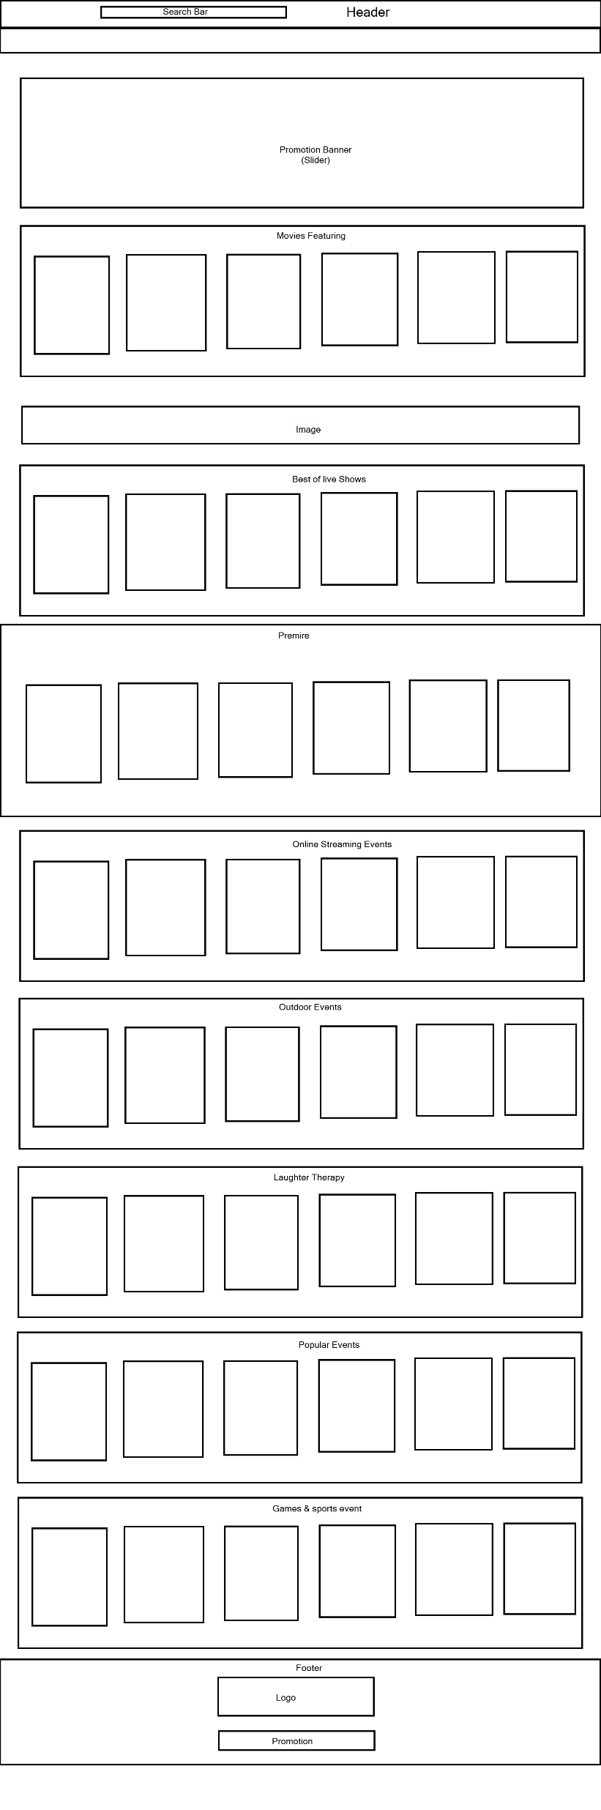
Modeling

Slide 10
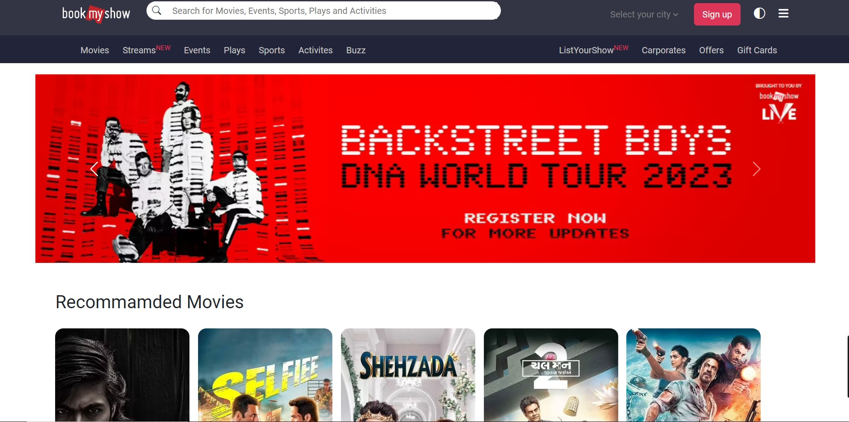
Result

Slide 11
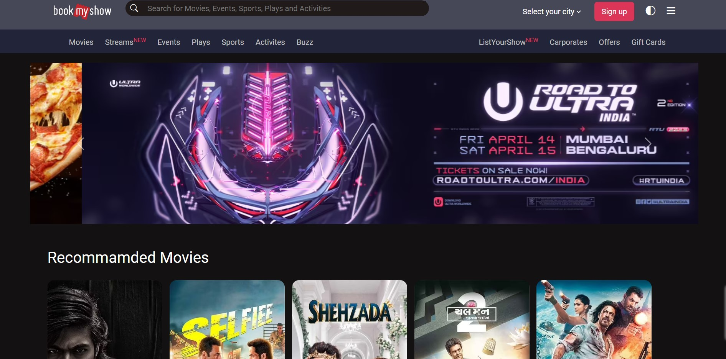
Result

Slide 12
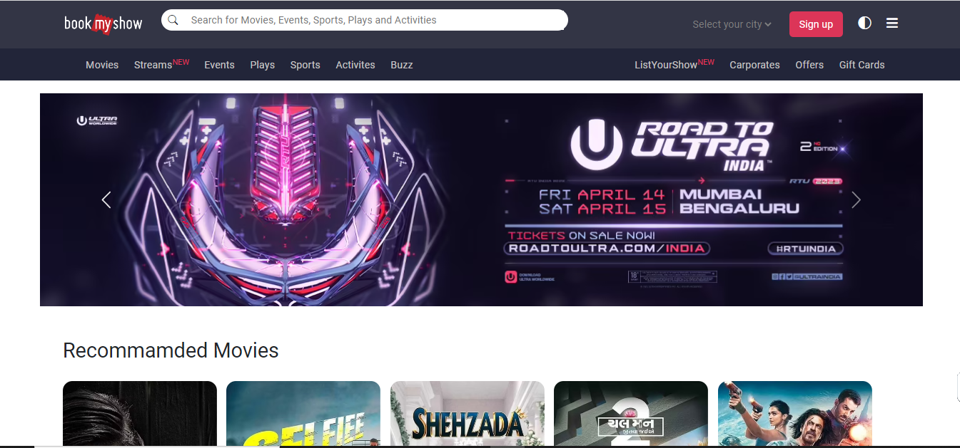
Result

Slide 13
Result
https://shwetalale25.github.io/CloneBookMyShow.comHomepageinDarkMode/

